Slide 1
SharePoint Framework Jump Start
SharePoint Fest Chicago
December 6, 2017
Presented By
Ryan Schouten

Slide 2





About Me
Ryan Schouten
Utah SharePoint User Group President
Worked with SharePoint for > 10 years
I have experience with SharePoint 2003 – 2016
I have worked with ASP.Net for 16 years
Microsoft MVP – Office Servers and Services
http://www.sharepointknight.com

Slide 3

Office365 Implementations
Custom SharePoint Development
Responsive Design
Intranet Design/Implementations
3

Slide 4
Agenda
9:00 – 9:15 Introductions
9:15 – 10:00 SharePoint Framework Intro
10:00 – 10:30 Extensions
10:30 – 10:45 Break
10:45 – 11:30 TypeScript
11:30 – 12:30 REACT and Office-UI Fabric
4

Slide 5
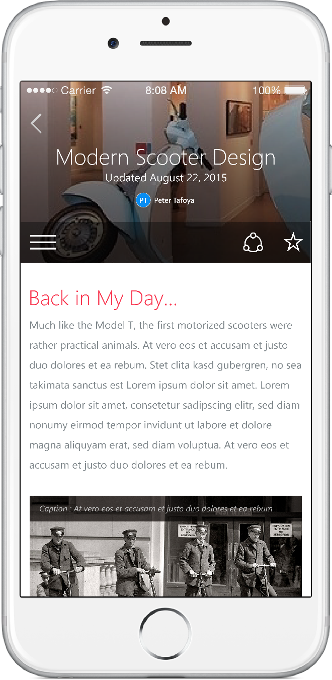
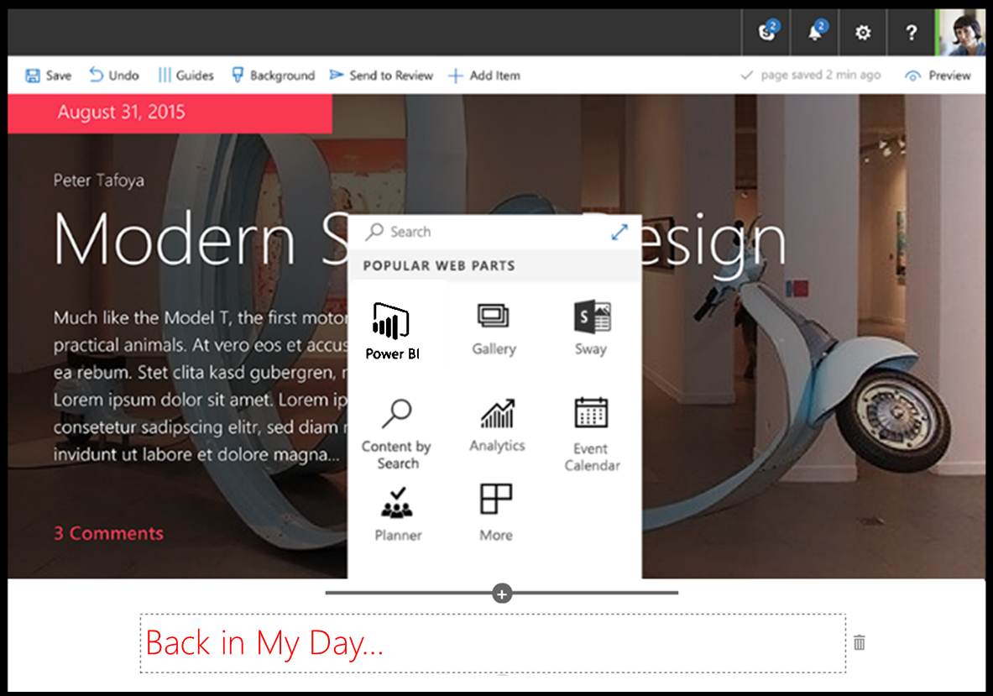
SharePoint Framework (SPFx)
Modern client-side development
Lightweight web and mobile
Powers our own experiences
Backward compatible
Supports open source tools and JavaScript web frameworks
SharePoint framework
Microsoft Graph
LOB Systems and Cloud Services
5

Slide 6









Open source tooling
Build Process & Tooling
JavaScript Frameworks
Code Editors
Yeoman Templates Gulp-based Build Process NodeJS/NPM SystemJS Webpack SASS TypeScript
React Angular
Knockout
and more … your choice!
Visual Studio Code Atom Sublime
and more … your choice!
6

Slide 7




Server side tool comparison
IIS Express
C#
MSBuild
Project Templates
7

Slide 8
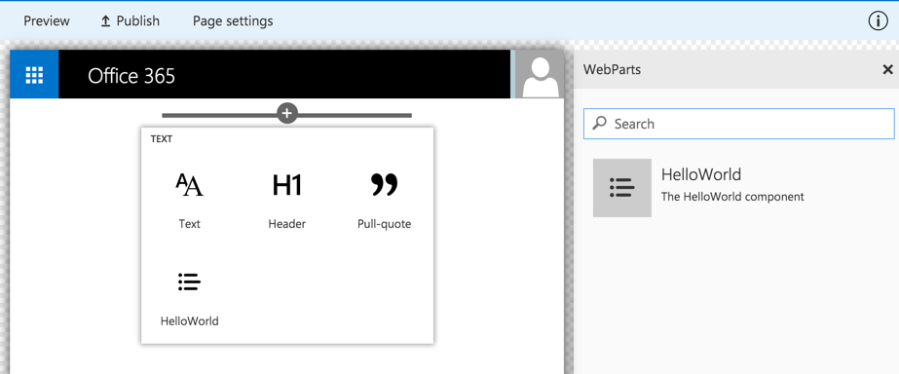
Client-side Web Part Build Flow
npm i @microsoft/generator-sharepoint -g
gulp serve
gulp package-solution
Install SharePoint Generator
Test
Package/Deploy
yo @microsoft/sharepoint
workbench local
gulp deploy-azure-storage
Scaffold SharePoint Web Part Project
Local
Package/Deploy
Code
workbench SPO
manual upload of the app
Build Web Part Code
UAT / Pre-production
Release using app catalog*
Ship?
Available on Classic and Client-Side Pages
8

Slide 9
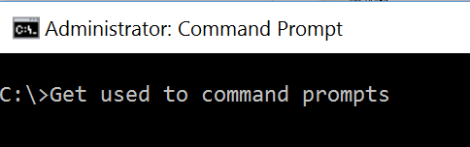
9

Slide 10
Demo
10

Slide 11
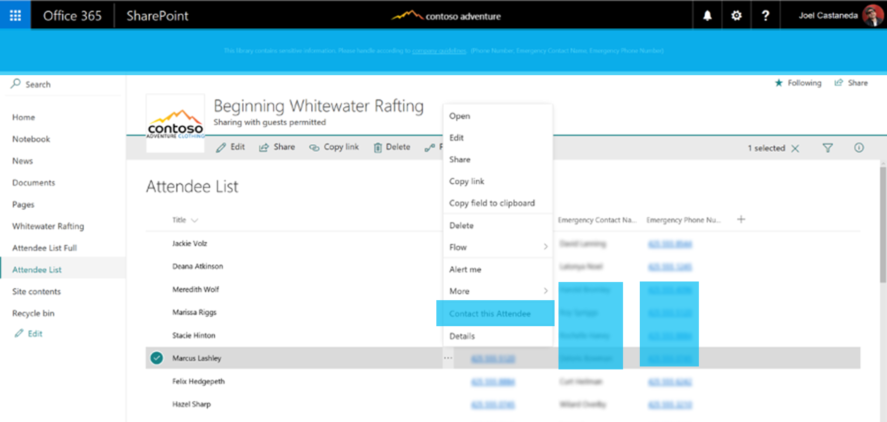
SharePoint Framework Extensions
Application customizer to extend UI or embed JavaScript
ListView Command Set for adding new buttons to toolbar or context menu
Field customizer to modify rendering of a field
11

Slide 12
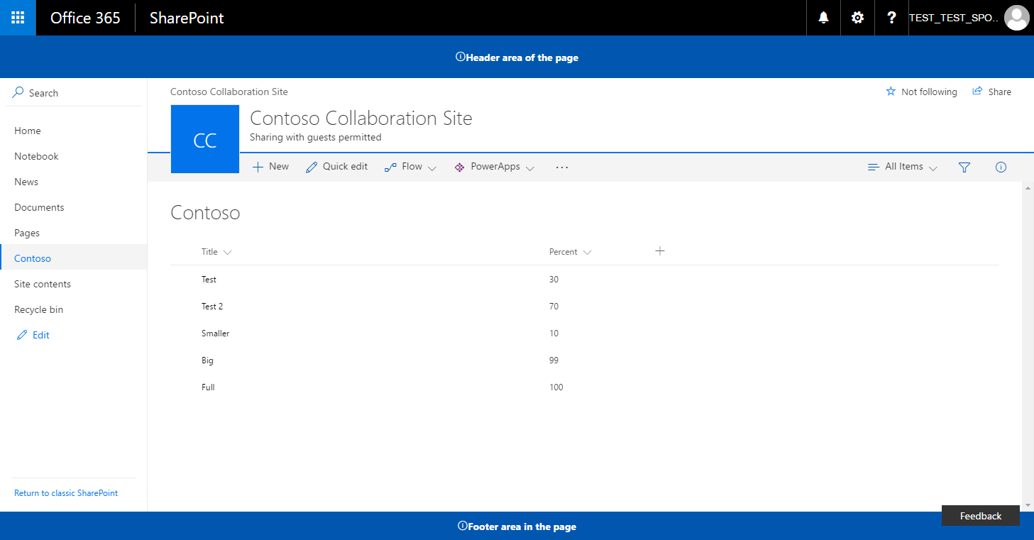
Logical architecture of an extension
SharePoint Online
SharePoint Framework Extension assets hosted from CDN. Could be also a folder or library in the SharePoint tenant, which acts as a centralized deployment location.
Extension
js
JavaScript Library
Extension
12

Slide 13
Application Customizer
Can be used to embed “visible” or hidden JavaScript on the SharePoint site
Can be associated to Site Collection, Site or a List scope
Associated ClientSideComponentId property at UserCustomAction collection
13

Slide 14
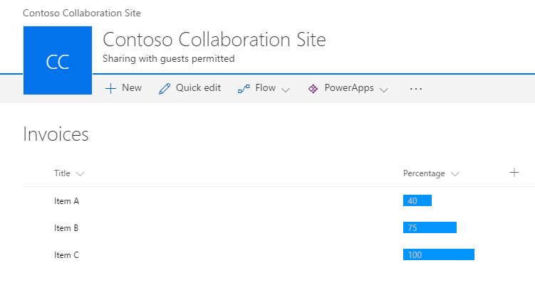
Field Customizer
Can be used to override field presentation in lists
Can be used with site columns or directly for a field in a list
Associated ClientSideComponentId property at Field object
Editing view experience override in the roadmap – June 2017
14

Slide 15
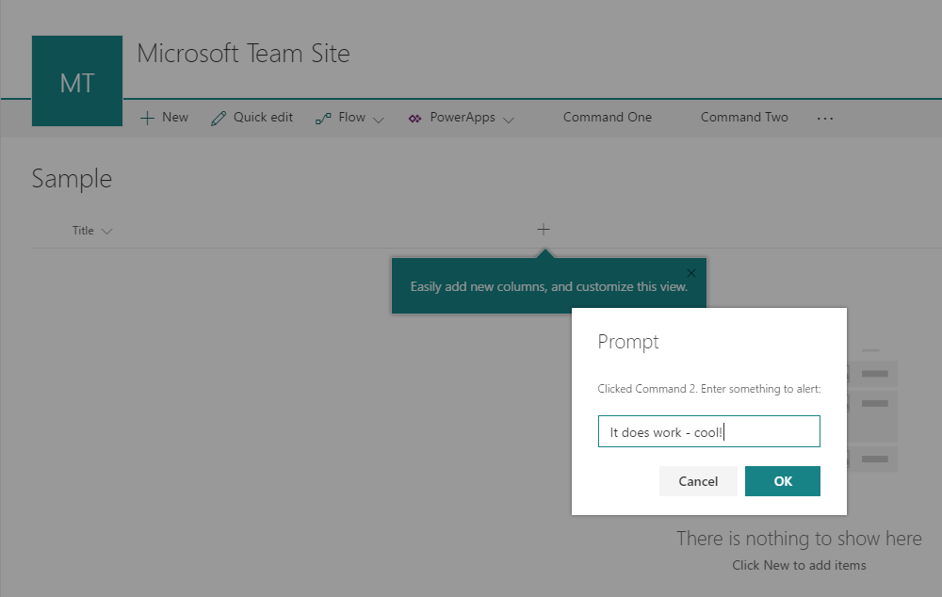
ListView Command Sets
ListView Command Set can be used to provide action buttons to lists
Supports toolbar and context menu
Associated ClientSideComponentId property at UserCustomAction collection
ListView Command Sets can be registered at site level to be valid for specific list types
15

Slide 16
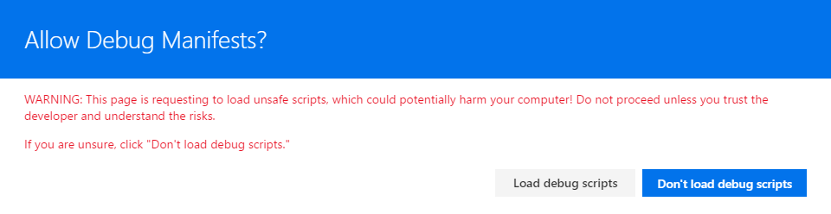
Debugging SharePoint Framework Extension
Debugging
Debugging happens in actual SharePoint Online sites
Code is hosted from the local web server - localhost
You can load your customization to normal pages using specific debug query parameters in browser
C
We are looking to have extension support also in SharePoint Framework workbench
16

Slide 17
Demo
17

Slide 18
What is TypeScript?
JavaScript Transpiler
Adds strong typing to JavaScript
Adds a lot of Object Oriented Programming concepts
18

Slide 19
New Functionality
Types
Enums
Classes
Interfaces
Modules
Function Changes
19

Slide 20
Types
Variables can be typed
Valid types
boolean
string
number
any
var variable:string;
20

Slide 21
Classes
We can easily define classes
Public/Private variables
Constructors
Inheritance
Static Properties
Get/Sets
21

Slide 22
Interfaces
Allow us to require certain properties/methods
Can be applied to function parameters, return types, classes, and functions
Properties can be marked as optional
22

Slide 23
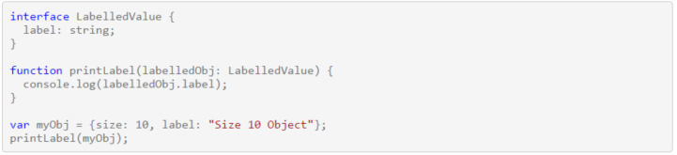
Interface Example
23

Slide 24
Functions
Functions can have return types
Parameters on a function are assumed required by default
Number of parameters to a function must match
Parameters can be marked as optional
Parameters can be given a default value
Both default and optional parameters must come after required parameters
24

Slide 25
Benefits
Compile time validation
Easier to understand code
Built in to VS 2015, Add-in available for other versions
Better Intellisense
25

Slide 26
Gotchas
Must reference the .d.ts file for custom libraries, most available from DefinitelyTyped GitHub Repo
.ts files must be transpiled to .js files
/// <reference path="jquery.d.ts"/>
26

Slide 27
Demo
27

Slide 28
Break
28

Slide 29

REACT
A JAVASCRIPT LIBRARY FOR BUILDING USER INTERFACES
29

Slide 30
React Key Components
Build Components
Re-Render, Don’t Mutate
Fast Virtual
DOM
30

Slide 31
REACT Components
Small, reusable widgets of your application
UI layout and the UI logic are tightly coupled
Can be individual or have a parent/child relationship
Use state for storing data within the component
Use props to pass data and events to a child component
31

Slide 32



Office UI Fabric
Fonts, icons
Colors
Front end experiences for SharePoint
Powers OOB experiences
Available out of the box
Design web part seamlessly
Office UI Fabric React for rich set of reusable controls
Components
32

Slide 33
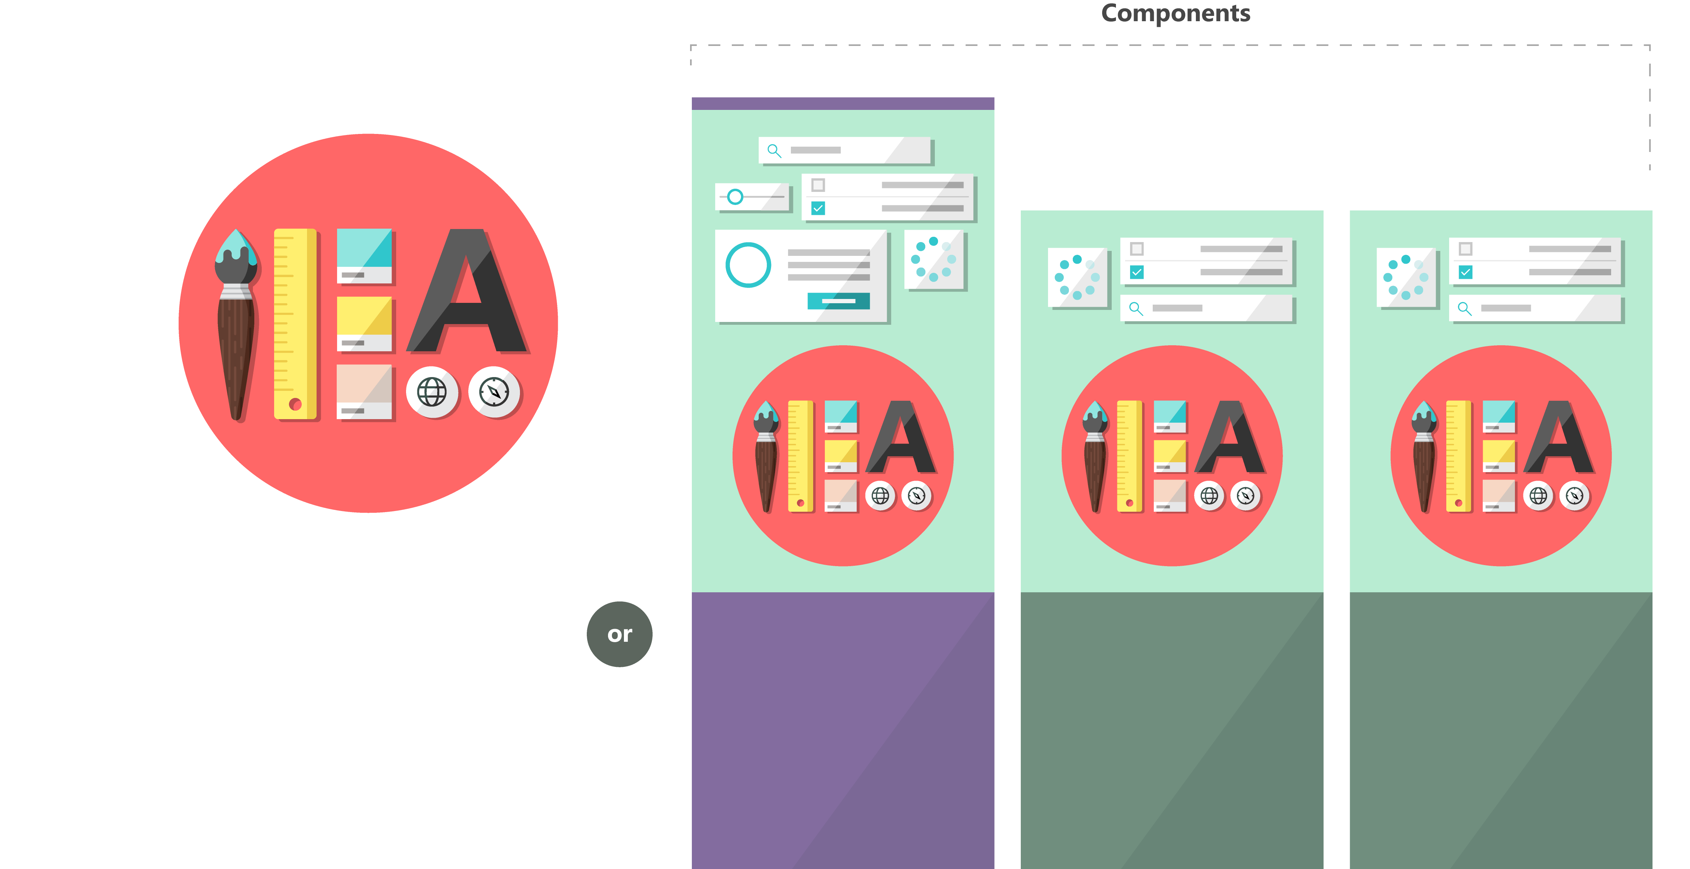

Fabric and its sub-projects
Fabric Core
Fabric React
Fabric JS
ngFabric
Fabric iOS
Core elements of the design language including icons, colors, type, and the grid
Robust, up-to-date components built with the React framework.
Simple, visuals-focused components that you can extend, rework, and build on.
Community-driven project to build components for Angular-based apps.
Native Swift colors, type ramp, and components for building iOS apps.
33

Slide 34
Demo
34

Slide 35
Deploying our SharePoint Framework Extension
Package Goes Into App Catalog
Our Bundle(s) needs to be deployed
CDN
SharePoint Library
Add App for our Package
Add Web Part to Page
35

Slide 36

Questions
36

Slide 37
Resources
SharePoint Framework Instructions - https://dev.office.com/sharepoint/docs/spfx/set-up-your-development-environment
User Voice - https://sharepoint.uservoice.com/forums/329220-sharepoint-dev-platform
TypeScript – http://www.typescriptlang.org
Office UI Fabric - http://dev.office.com/fabric
Code - http://bit.ly/2uqfX6B
37

Slide 38
Thank You
www.sharepointknight.com
@shrpntknight
ryan@sharepointknight.com

